Slide 1
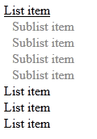
Homework
Create tree view like the following:
When the mouse goes over an item the sub list should be shown
The tree view should work with unlimited number of sub lists

Slide 2
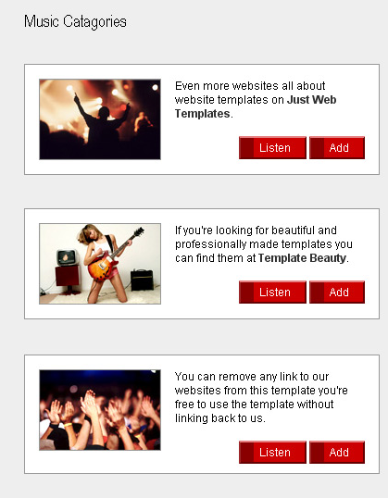
Homework (2)
Create the following Web page using external CSS styles. Buttons should consist of PNG images with text over them.

Slide 3
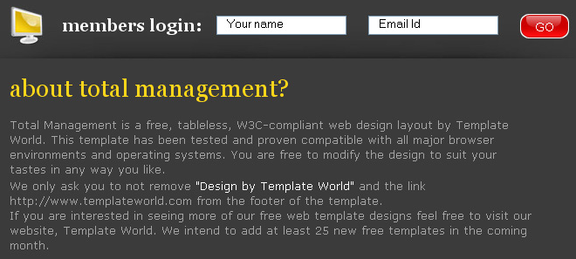
Homework (3)
Create the following Web page using HTML with external CSS file. Note that the images should be PNG with transparent background.

